Slide 1
X.509 certificate
Srilakshmi, K
Tambat, Amarnath
Charbhare, Kapil
Mukesh, Rayavarapu
Raja, Vignesh

Slide 2
What is certificate?
Certificate is a form of electronic credential that can prove the authenticity of a user, device, server, or website.
Certificates are used to sharing highly confidential and personal information. (online banking records, medical reports, etc,.)

Slide 3
Why we need Certificate?
Protocols like TLS(Transport Layer Security) are used to secure the connection between browser and the server. But, TLS helps us only when the communicating person is known.
Replacing the pre-shared key requires updating it on all systems, which can be tedious.
A compromised certificate only needs to be replaced on the system to which the certificate belongs.
Certificates bind the owner to their public key. Certificate allow us to verify to whom the public key belongs to.
Types : TLS/SSL certificate, code signing certificate and client certificate.

Slide 4
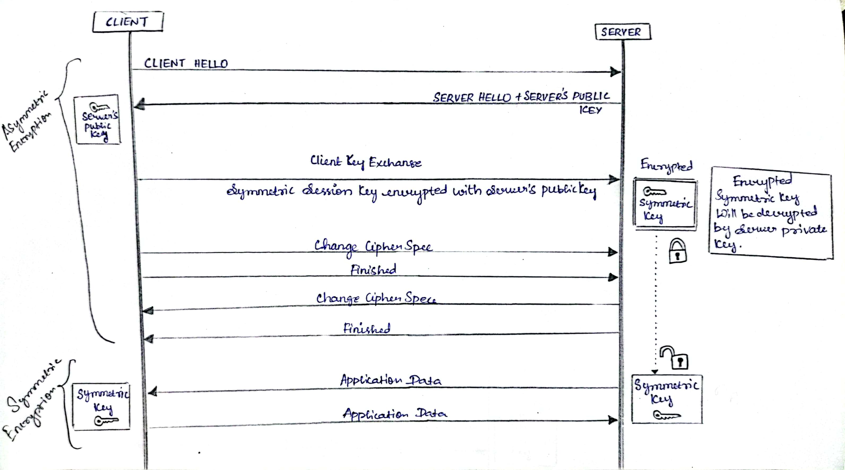
Normal TLS connection

Slide 5
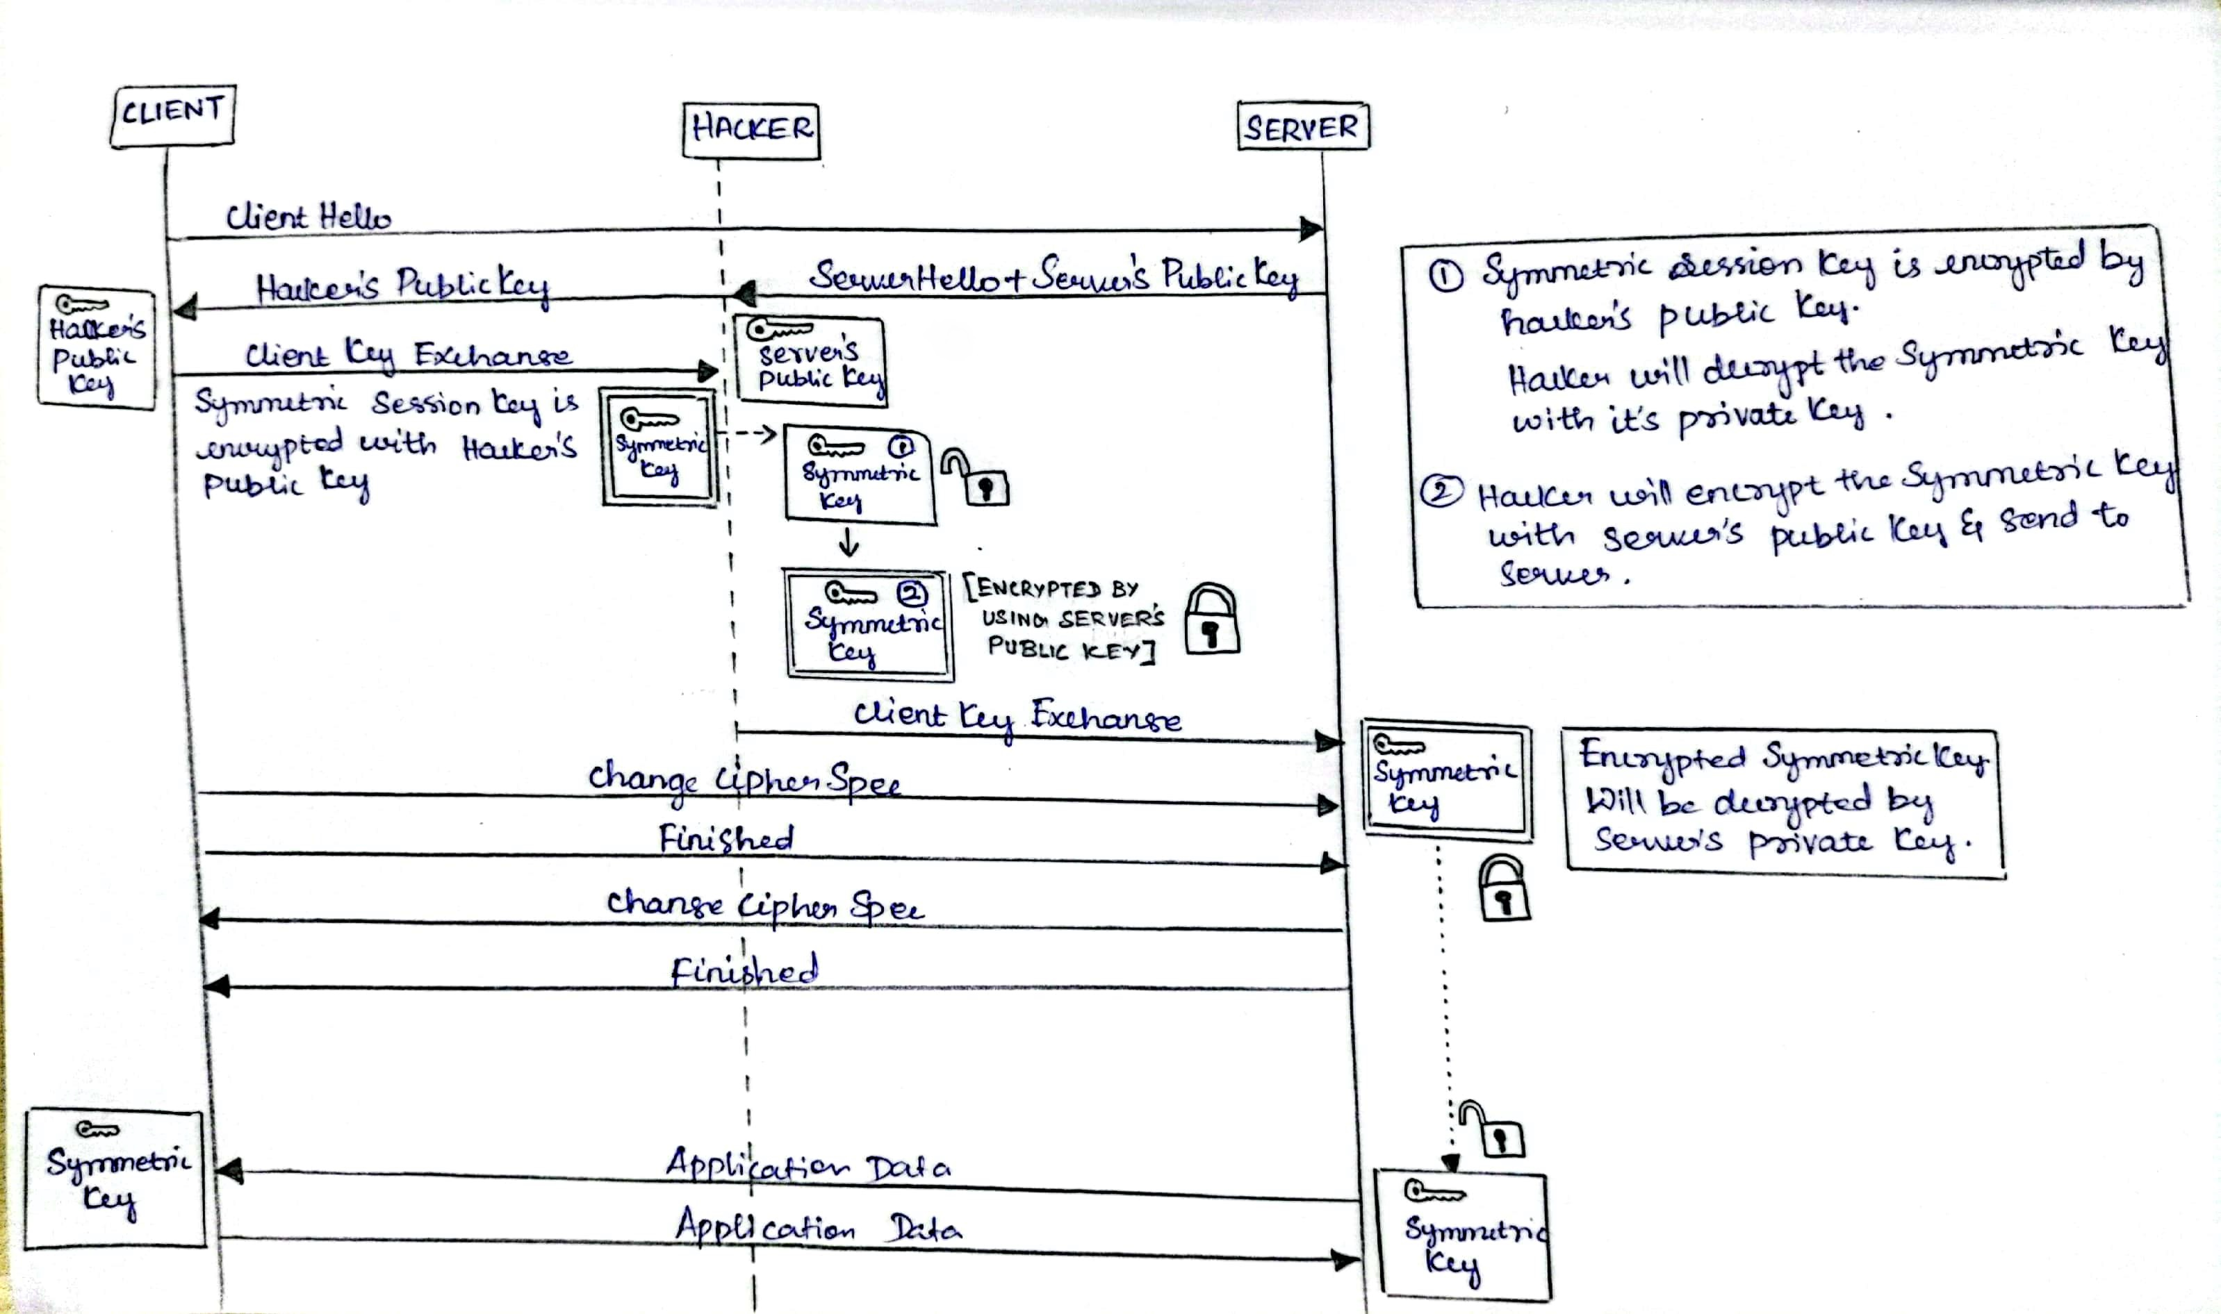
Problem in TLS

Slide 6
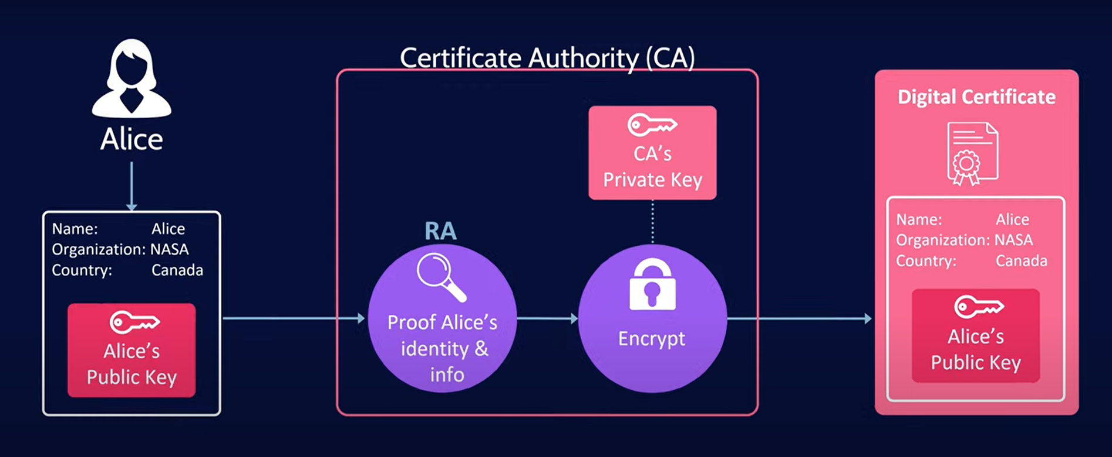
Generating Certificate

Slide 7
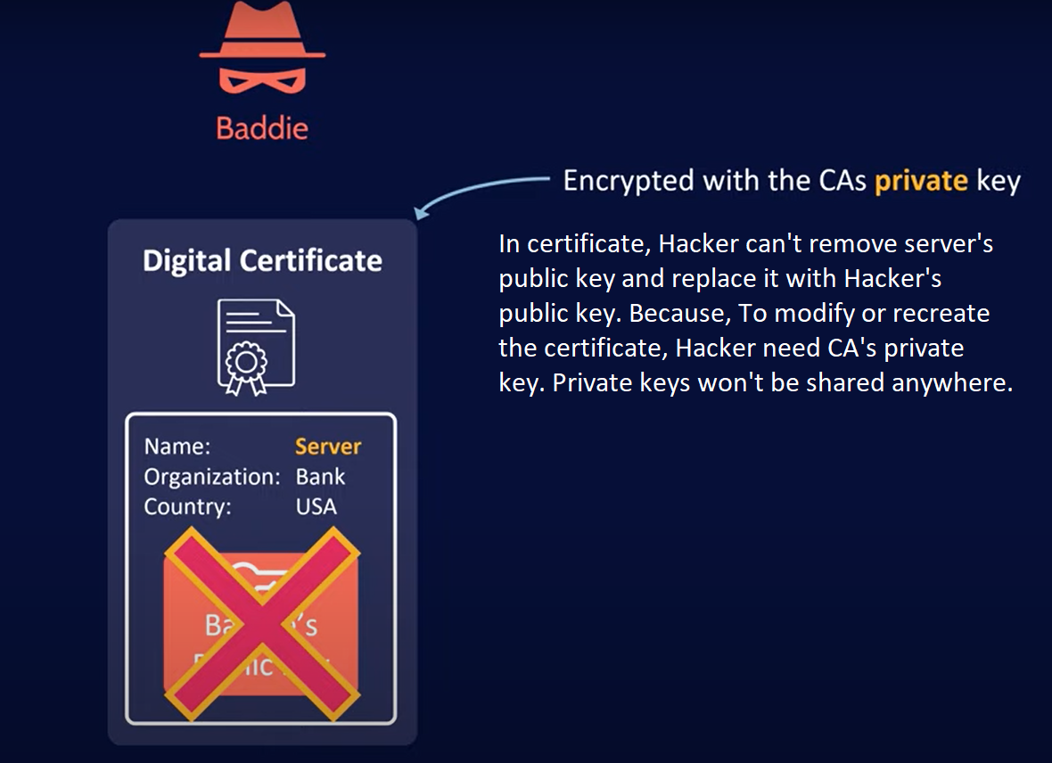
Hacker lost

Slide 8
What is Certificate Chain of Trust?
The SSL/TLS internet security standard is based on a trust relationship model, also called “certificate chain of trust”.
A certificate chain is an ordered list of certificates, containing an SSL/TLS Certificate and Certificate Authority (CA) Certificates, that enable the receiver to verify that the sender and all CA's are trustworthy.
Certificate Authority is an entity that stores, signs, and issues digital certificates.
There are three parts of chain of trust, they are root CA, intermediate CA and end-entity certificate.

Slide 9
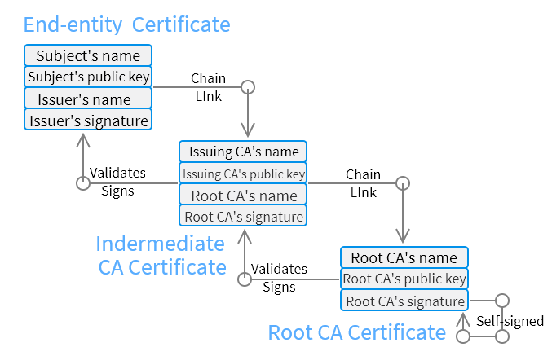
Certificate Chain

Slide 10
Root CA Certificate
A Root SSL certificate is a certificate issued by a trusted certificate authority (CA).
In the SSL ecosystem, anyone can generate a signing key and use it to sign a new certificate. However, that certificate isn’t considered valid unless it has been directly or indirectly signed by a trusted CA.

Slide 11
Intermediate CA certificate
Any certificate that sits between the SSL/TLS Certificate and the Root Certificate is called a chain or Intermediate Certificate.
The Intermediate Certificate is the signer/issuer of the SSL/TLS Certificate.
The Root CA Certificate is the signer/issuer of the Intermediate Certificate.
If the Intermediate Certificate is not installed on the server (where the SSL/TLS certificate is installed) it may prevent some browsers, mobile devices, applications, etc. from trusting the SSL/TLS certificate.
In order to make the SSL/TLS certificate compatible with all clients, it is necessary that the Intermediate Certificate be installed.

Slide 12
End entity certificate
The end-entity provides critical information to the issuing CA via a Certificate Signing Request form.
The certificate is then signed and issued by a trusted CA, attesting that the information provided was correct at the issuance time.
The SSL connection to a server will fail if the certificate has not been verified and signed.

Slide 13
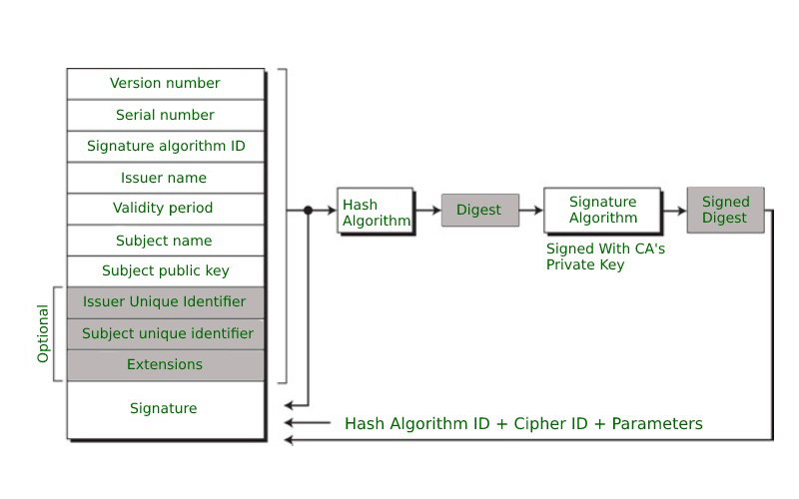
FIELDS IN X.509 CERTIFICATES :-

Slide 14
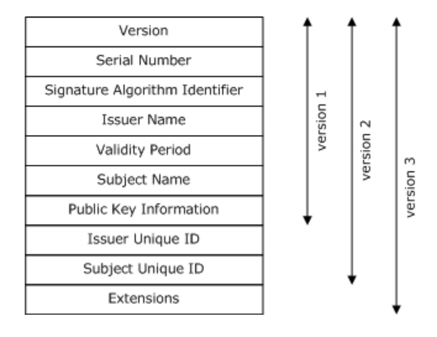
CONT..
VERSION NUMBER:-
  It defines the x.509 version that concerns the certificate.
  This identifies which version of the x.509 standard applies to this certificate which affects what information can be specified in it.

Slide 15
CONT..
SERIAL NUMBER :-
  It is the unique number that the certified authority issues that distinguishes the certificates from others.
  Every x.509 conforming CA generates a unique serial number for each issued certificate
  which in fact is a long integer serial number must be unique, not greater than 20 bytes.

Slide 16
Signature Algorithm identifier :-
This is the algorithm that is used for signing the certificate.
A signature algorithm is used to sign the piece of data and to calculate its hash with a certain hash function.
This is issued by the issuer before signing the certificate he will select what signature algorithm he will use to sign the certificate.

Slide 17
CONT…
ISSUER NAME :-
  The name of the person who issued the certificate. Usually it is Certificate Authority(CA)
VALIDITY PERIOD :-
  It defines the period for which the certificate is valid.
  It gives us the start and end date, as well as the time the certificate is valid and can be trusted.
SUBJECT NAME :-
Tells about the name of the user to whom this certificate has been issued.

Slide 18
CONT…
PUBLIC KEY INFORMATION :-
It defines the subject’s public key along with an identifier of the algorithm for which this key is supposed to be used.
In order to encrypt or decrypt the information the user will be using public key so
that public key information is present here.
ISSUER UNIQUE ID:-
Each issuer has a unique id and that id will be present here.
SUBJECT UNIQUE ID:-
Each subject has a unique id and that id will be present here. PUBLIC

Slide 19
CONT…
EXTENSIONS :-
  X.509 version 3 certificates include a list of extensions that can be used to obtain additional information on the subject or the issuer of the certificate. Those may be e mail addresses, flags that indicate whether the belongs to a CA etc.
  An X.509 v3 certificate contains an extension field that permits any number of additional fields to be added to the certificate. Certificate extensions provide a way of adding information such as alternative subject names and usage restrictions to certificates.
  Extensions have their own unique Id’s expressed as a set of values called an object identifier.
  An extension can be rejected if it is not recognized or if the extension has information that can’t be processed.

Slide 20
CONT…
SIGNATURE :-
  This field contains the hash code of all other fields which is encrypted by the certified authority private key.
  SIGNATURE ALGORITHMS :-
  md5withRSA encryption
  sha1withRSA encryption
  sha224withRSA encryption
  HASH ALGORITHMS :-
  MD-5
  SHA-256
  RIPEMD-160

Slide 21
Overview of certificate creation
Now see how to create certificate and how it works between server and client.
Creating certificate consists of three main components. They are
Key Pair: It consists of two keys -- Public key and private key. A private key allows you to sign the document so that the intended person can verify the signature using the public key related to it.
Digital Signature: A digital signature is added by a certificate authority (CA) to assure users that the certificate in use is genuine.
Identity information: It also consists of information related to the party to which a certificate is issued & the identity that issued it (certificate authority).

Slide 22
Continue………..
First of all ,create the root certificate(certificate authority) which is also called as self-signed certificate by using its own private key.
For creating server certificate, we have to give certificate signing request to certificate authority.
That CSR contains that name, organization and email and server public key.
The server signs this CSR by using its own private key.
Now CA verifies the sever information and signature by using server’s public key.
If everything is verified and valid the CA signs the certificate by using their own private key and sends that certificate to the server.
Client also follow this same procedure for creating client certificate.

Slide 23
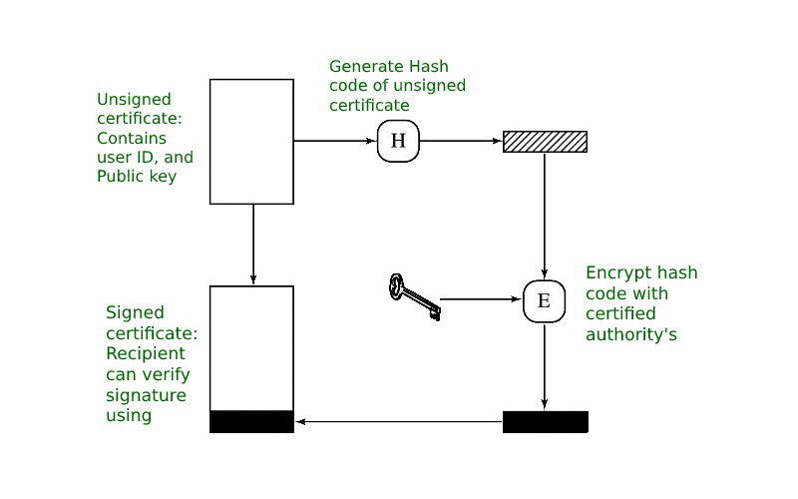
X.509 Certificate Mechanism

Slide 24
How certificate works between server and client
Server sends a copy of its SSL certificate, including server public key.
Client checks that the certificate is trusted by using digital signature.
To sign a document the signer first need to hash it, then hash value is encrypted using the signer’s private key.
Hashing is a key way you can ensure important data, including passwords, isn't stolen by someone with the means to do you harm.
Mostly used hash algorithms are MD-5,SHA-256, RIPEMD-160.
Mostly used signature algorithms are:
md5WithRSAEncryption.
sha1WithRSAEncryption.
sha224WithRSAEncryption.
sha256WithRSAEncryption.

Slide 25
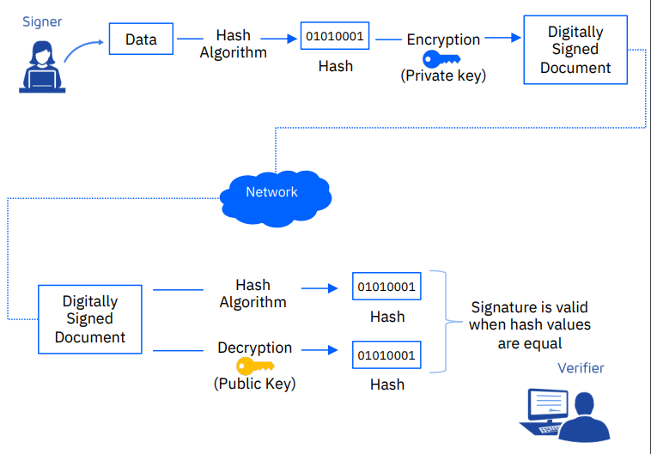
Verify the digital signature:

Slide 26
Conti………
First detach the signature from the document, and decrypt with signer’s public key to get hash value.
Then the hash the document with same hash algorithm used in the signed process, now result is another hash value.
Now compare two hash values if there is same the signature is valid.
If the hash values are not same then client thought that the data is altered by third party.
If the hash values are same then it continue with next step in handshake process.

Slide 27
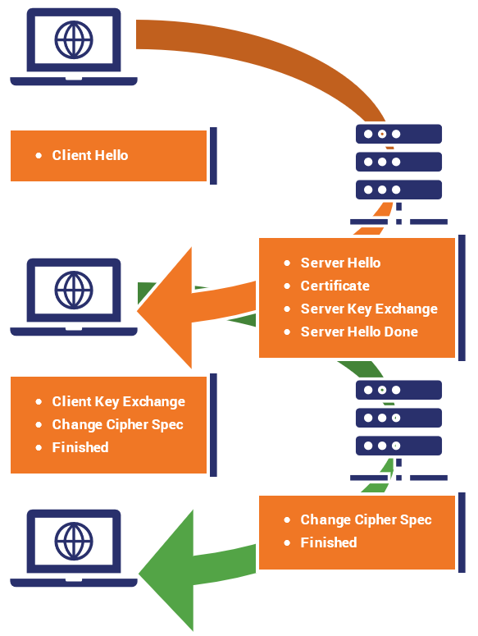
Handshake process:

Slide 28
Cont…
Now client has server public key and it creates one session key and encrypt that session key by using server public key and sends to server .
Server by using private key decrypts the session key .
Now both have session key and they can securely communicate with each other.

Slide 29
Symmetric Encryption
What is Symmetric Encryption ?
Symmetric Encryption is a type of encryption where only one key (public key) is used to both encryption and decryption of the data.
The entities communicating via symmetric encryption must exchange the key so that it can be used in the decryption process.
In other terms, Data is encrypted and decrypted using the same key called as public key or secret key.
Symmetric key encryption is sometimes called as secret key encryption.

Slide 30
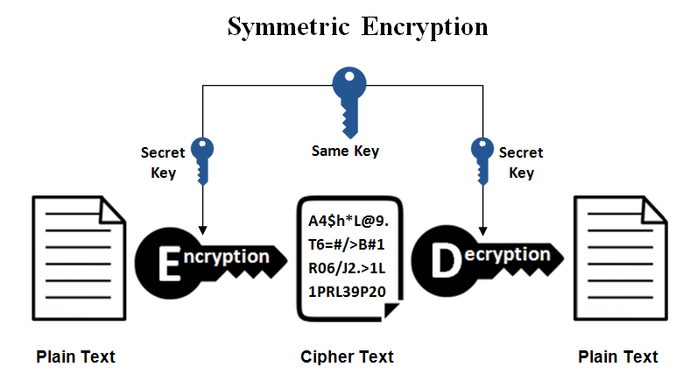
(Cont…)
How Does Symmetric Encryption Work ?

Slide 31
(Cont…)
Symmetric Encryption Algorithms: -
Advanced Encryption Standard (AES)
Rivest Cipher (RC4)
Data Encryption Standard (DES)
The International Data Encryption Algorithm (IDEA)

Slide 32
(Cont…)
Merits: -
Simpler to implement and less complex.
The encryption process is very fast.
It is used when a large amount of data is required to transfer.
De-Merits: -
Security is less as only one key is used for both encryption and decryption purpose.
Easy for hackers to get the key as it is shared in unsecure way.

Slide 33
Asymmetric Encryption
What is Asymmetric Encryption ?
Asymmetric encryption uses two keys for encryption and decryption. It is based on the technique of public and private keys.
Data encrypted using a public key.
Data is decrypted by using a private key.
The public key used in this encryption technique is available to everyone, but the private key used in it is not disclosed.
Only the owner of the private key can decrypt the data sent to them.

Slide 34
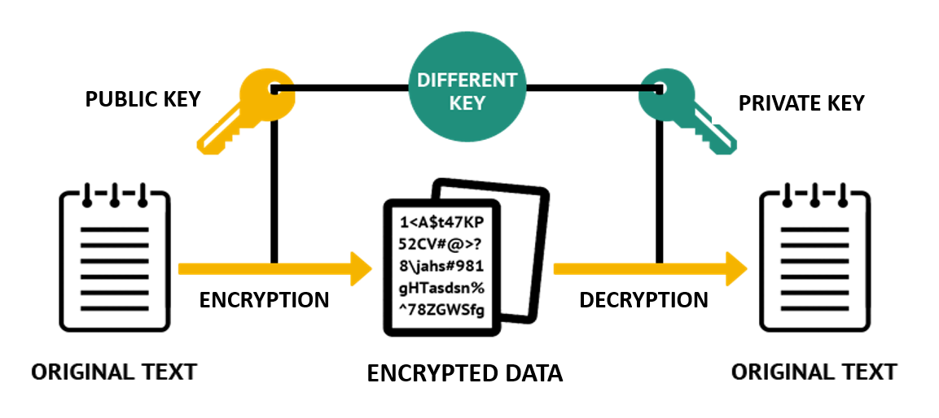
(Cont…)
How Does Asymmetric Encryption Work ?

Slide 35
(Cont…)
Asymmetric Encryption Algorithms: -
Digital Signature Algorithm (DSA)
Rivest-Shamir-Adleman (RSA)
Diffie-Hellman
Pretty Good Privacy (PGP)

Slide 36
(Cont…)
Merits: -
More secure than symmetric encryption.
Increases data security.
Authentication.
De-Merits: -
Slower than symmetric encryption.
More complicated to implement than symmetric encryption.
Used only for short messages.

Slide 37
TLS
What is TLS ?
TLS stands for Transport Layer Security.
It is a cryptographic protocol used to secure data sent over a network, like internet traffic.
General use cases include securing email, online transactions, file transfers, and instant messages.
TLS secures the transmission and delivery of data.
It is a security protocol for HTTPS connections and not for insecure HTTP connections.
The main difference between DTSL and TLS is that DTLS uses UDP and TLS uses TCP.

Slide 38
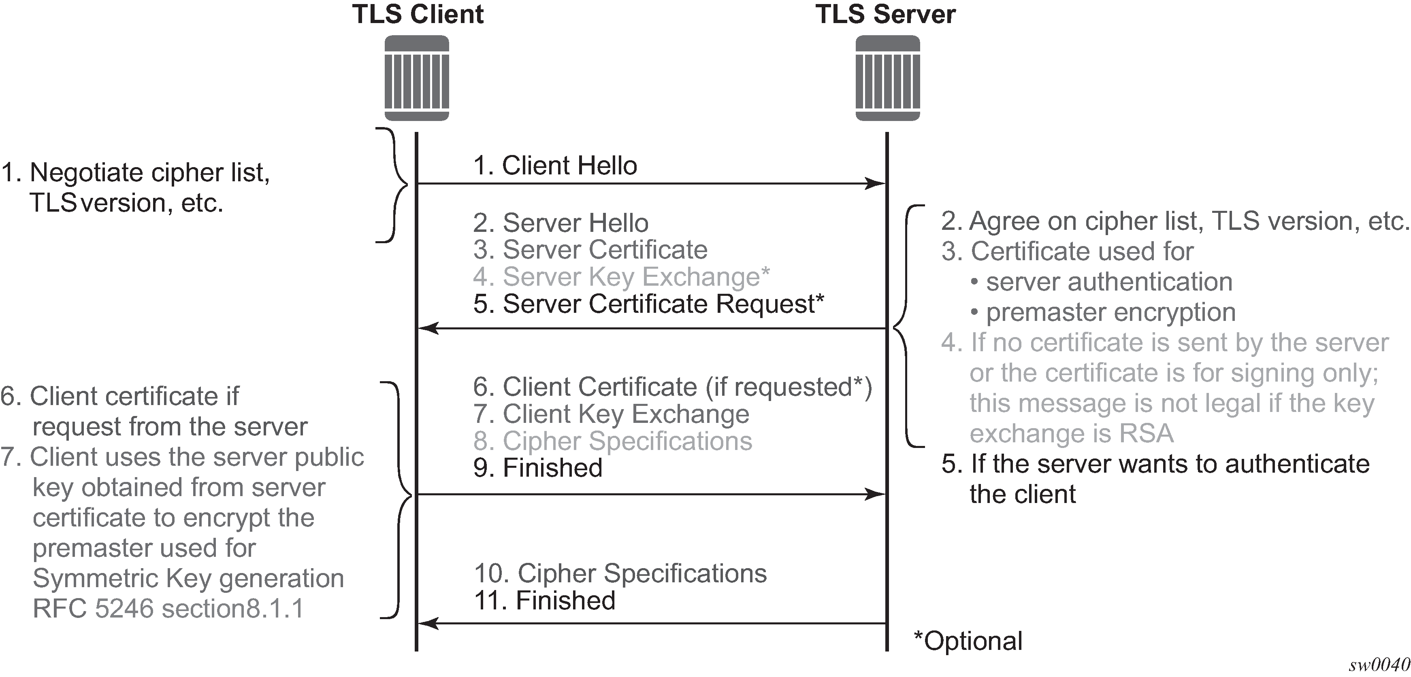
TLS Handshake

Slide 39
(Cont…)
What is DTLS ?
DTLS stands for Datagram Transport Layer Security. It’s a session layer communications protocol designed to protect data privacy.
DTLS is based on the Transport Layer Security (TLS) protocol, which provides security to computer-based communications networks.
The main difference between DTSL and TLS is that DTLS uses UDP and TLS uses TCP.
The reason that TLS can not be use directly in datagram environments is simply that packets may be lost or reordered.
DTLS solves the problems of reordering or packet loss by using a retransmission and sequence number in DTLS handshake

Slide 40
DTLS
The DTLS Handshake Protocol: -
DTLS uses all of the same handshake messages and flows as TLS, with three changes:
A stateless cookie exchange has been added in DTLS to authenticate client.
DTLS handle message reordering.
Retransmission timers to handle message loss.

Slide 41
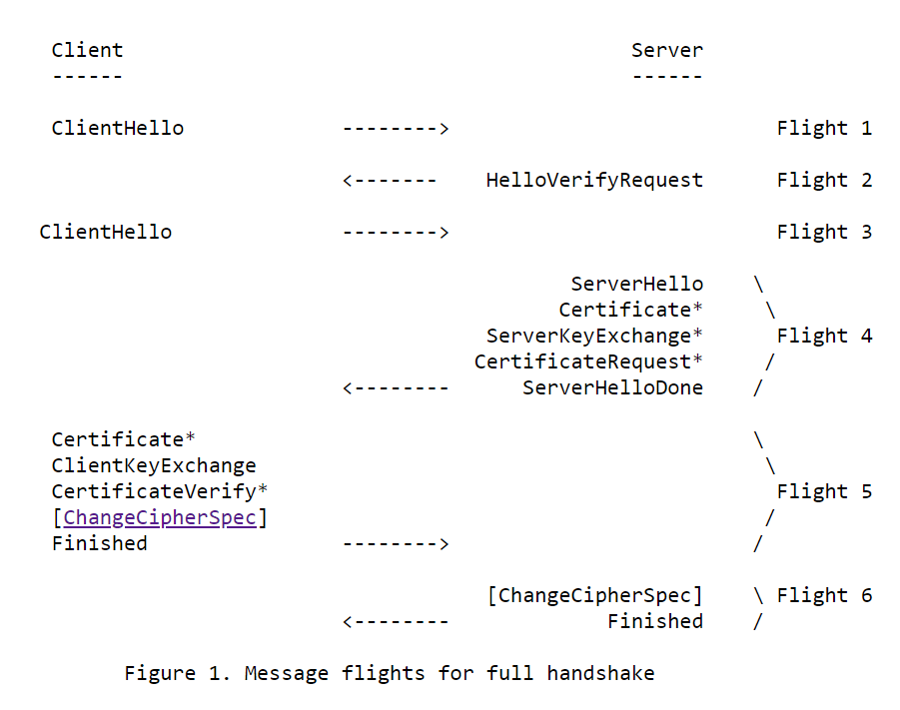
DTLS Handshake

Slide 42
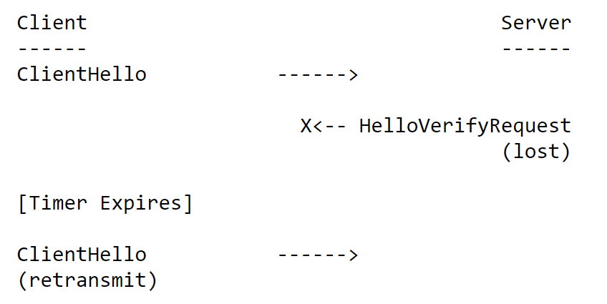
(Cont…)
How DTLS avoid Packet Loss ?
DTLS uses a simple retransmission timer to handle packet loss.
The server also maintains a retransmission timer and retransmits when that timer expires.

Slide 43
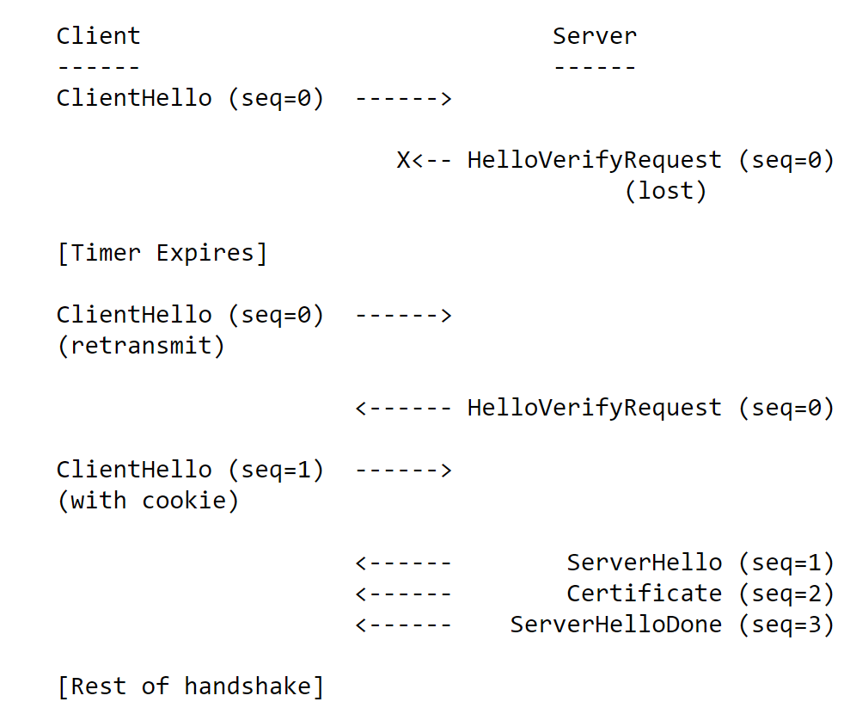
(Cont…)
How DTLS avoid reordering ?
In DTLS, each handshake message is assigned a specific sequence number within that handshake.

Slide 44
Creating CA certificate(Root certificate):
  Generate private key for CA certificate:
    Openssl gensra 2048 > ca-key.pem
  Generate the x509 certificate for CA:
    Openssl req –new –x509 –nodes –days 365 –key ca-key.pem –out ca-cert.pem
Notes:
Openssl: software library for application secure communication over computer network against evesdropping or need to identify the party at the other end. Openssl uses the RSA algorithm for encryption of public key.
gensra: Genrate RSA private key. RSA private key is used to generate digital signature and also used to verify digital signature.
Req: command create and process certificate request in pksc#10 formate.

Slide 45
Creating the Server's Certificate and Keys
  Generate the private key and certificate request:
    Openssl req –newkey rsa:2048 –nodes –days 365 –keyout server-key.pem –out server-req.pem
  Generate the X509 certificate for the server:
    Openssl x509 req –days 365 -set-serial 01 –in server-req.pem –out server-cert.pem –ca ca-cert.pem –CAkey ca-key.pem
  Verify the server certificate
    Openssl verify –CA file ca-cert.pem ca-cert.pem server-cert.pem
Notes:
Newkey: create new private key.
Keyout: is going to be key file , where our key are store with name server-key.pem.
Server-req.pem: request for signature from the certificate authority (CA).
Server-key.pem: used to store the ssl certificate and their associated private key.
CA: used to sign certificate req.
Set-serial: CA serial number is created if it does not exist.
Verify: verify certificate chains.
CA file: A file of trusted certificate, this file should contain multiple certificate in pem .

Slide 46
Creating the Client's Certificate and Keys:
  Generate the private key and certificate request:
    Openssl req –newkey rsa:2048 –nodes –days 365 –keyout client-key.pem –out client-req.pem
  Generate the X509 certificate for the client:
    Openssl x509 req –days 365 -set-serial 01 –in client-req.pem –out client-cert.pem –ca ca-cert.pem –CAkey ca-key.pem
  Verify the client certificate:
    Openssl verify –CA file ca-cert.pem ca-cert.pem client-cert.pem

Slide 47
Connecting client and server with certificate with TLS:
  In server end :
    openssl s_server –accept 4433 –cert server-cert.pem –key server-key.pem –debug –state –verify 1
  In client end :
    openssl s_client –showcert –connect 10.91.240.147:4433 –cert client-cert.pem –key client-key.pem –debug –msg –state
Notes:
Showcert: show all the certificate in chain.
Debug: extra output
msg: show protocol message.
State: print the ssl state.

Slide 48
Connecting client and server with certificate with DTLS:
  In server end :
    openssl s_server –accept 4433 –cert server-cert.pem –key server-key.pem –debug –state –verify 1 –dtls
  In client end :
    openssl s_client –showcert –connect 10.91.240.147:4433 –cert client-cert.pem –key client-key.pem –debug –msg –state –dtls

